Slide 1
Bug Clicker Game

Slide 2
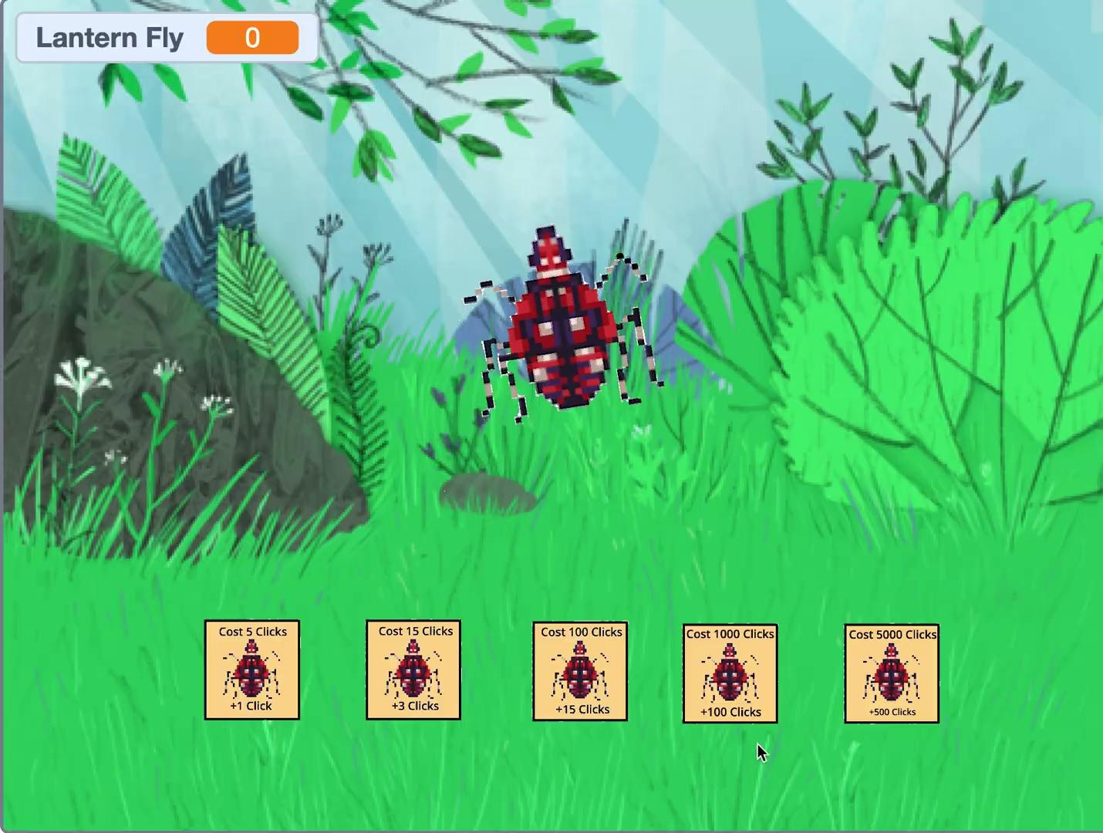
Version 1
Made using scratch
Not many menu options
Very Basic

Slide 3
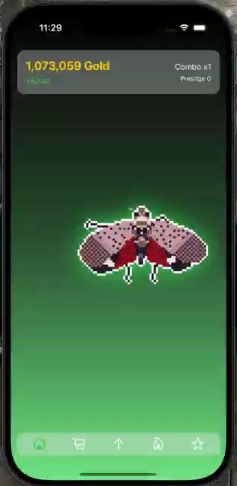
Version 2
Made using xcode
Different menus available now
Put in a better money system
Added a boss

Slide 4
Next Steps/ Message
Works on the menus a little more
Add different animations and movement for the bug, mainly for the boss page
Add a factor that could make people play the game for a longer term
Add something different than the prestige system

